Slide 1
A WEB-BASED COVID-19 TEST PREDICTION SYSTEM USING NEURAL NETWORK BY AJIBOYE OLUWAFERANMI KELECHI MATRIC NUMBER: 180202003 Department Of Physical And Computer Sciences, College of Natural and Applied Sciences, McPherson University, Seriki Sotayo, Ogun State. SUPERVISORY TEAM Dr Femi Ayo Emmanuel (Major Supervisor) Mr Abiodun Mustapha (Co-supervisor)

Slide 2
PRESENTATION OVERVIEW
Introduction.
Statement of Problem
Justification of Study.
Aim and Objectives.
Literature Review.
Methodology
Implementation
Contribution to Knowledge
References

Slide 3

INTRODUCTION
An Artificial Neural Network (ANN) is a network or circuit of biological neurons. It is a method in artificial intelligence that teaches computers to process data in a way that is inspired by the human brain. (Sara Brown, 2021)
COVID-19 is a deadly disease originating from a family of viruses knows as coronaviruses characterized by a core of genetic material covered with protein spikes. (Velavan & Meyer, 2020)
This virus is rapidly transmitted through respiratory fluids and has no direct cure at the time of this research. (WHO, 2022)

Slide 4
STATEMENT OF PROBLEM
The standard test for diagnosing COVID-19 in a patient is the RT-PCR test: Reverse Transcriptase-Polymerase Chain Reaction (Fegert et al, 2020)
This testing procedure has multiple limitations including cost, limited kits available, speed of testing process (Afzal & Adeel, 2020).
With the rapid spread of the virus, triaging patients is a time-consuming process particularly for developing countries (Liu et al, 2020).

Slide 5
JUSTIFICATION OF STUDY
Research shows that an increased rate of testing patients will reduce the spread of the virus (Liu et al, 2020)
Testing should and must be made available to humans in all countries
AI can aid identification of hotspots of the virus. This can help government agencies enact lockdown and isolation rules in the region (Sivasubramanian, 2020)
Public data of the virus and how it can be detected will be increased when people can take preliminary diagnostic tests online (Abbasi et al, 2021)

Slide 6
AIMS AND OBJECTIVES
The aim of this study is to develop a web-based system that can detect the presence of COVID-19 in a patient using symptoms and other user data without performing a physical test
SPECIFIC OBJECTIVES
Perform a critical analysis on existing systems for detecting the coronavirus in patients using symptoms
Design a web-based system for detecting coronavirus without performing actual coronavirus test
Implement the system in Javascript and validate system performance and reliance

Slide 7
LITERATURE REVIEW
Title | Objectives | Methodology | Strengths | Limitations
Application of Big Data Analytics to Control COVID-19 Pandemic (Mei et al, 2021) | To reduce the spread of the coronavirus throughout the world by application of Big Data Analytics techniques | Placed sensors on certain areas of patient’s body to gather information including: temperature, blood pressure etc. Made use of tools like MATLAB, MS Excel, Python & R to analyze the information acquired | Due to the increase in the volume of data over time as the pandemic continues to effect various countries over the world, the credibility of the author’s work will continue to scale globally leading to a rise in the accuracy. | Confidentiality within patients with the virus lead to limited clinical data available depending on the category. The difficulties involved in sharing data with other researchers to enhance their work.
An expert system to diagnose COVID-19 and predict its severity using chest CT scans (Abbasi et al, 2021) | An Inexpensive and concise diagnostic test for majorly asymptomatic patients. Design a system that can detect the severity of the virus in the patient | Deep Learning Techniques and three separate ML classification procedures: | Available to the public through a webserver code. Detects not just the presence of COVID in a person but also determines the severity to determine counter measures | Method of application and consensus findings are applicable to a certain geographic region, leading to possible inaccuracy of the model in other locations

Slide 8
LITERATURE REVIEW
Title | Objectives | Methodology | Strengths | Limitations
Artificial Intelligence-enabled rapid diagnosis of patients with COVID-19 (Alsunaidi et al, 2021) | To provide an alternate medium to testing COVID than the standard PCR test which takes up to 48 hours to complete | Convolutional Neural Networks with Chest CT Scan dataset and other clinical information from a survey to detect COVID-19 | Test analysis for result prediction is 68% valid and this rapidly reduced the time taken averagely to detect COVID patients without AI | Detection of COVID in patients by the CNN model yielded only a 52% probability of success as from 25 patients, only 13 were detected
A model for the effective COVID-19 identification in uncertainty environment using primary symptoms and CT scans (Abdel-Basst et al, 2020) | To Create a diagnosis model for COVID-19 assumption and diagnosis of medical signs to describe proper care methods | The authors made use of the BWM (Best Worst Method) to assess a group of surrogate options with consideration to a group of decision parameters. The BWM is based off a systematic pairwise comparison of the decision criteria | Model requires primary symptoms for its training | Method of application and consensus findings are applicable to a certain geographic region, leading to possible inaccuracy of the model in other locations

Slide 9
LITERATURE REVIEW
Title | Objectives | Methodology | Strengths | Limitations
COVID-19 symptoms predictive of healthcare workers' SARS-CoV-2 PCR results (Lan et al, 2020) | To provide a symptom-based screening approach among health workers that will prove crucial in eliminating the spread of the virus. | We performed a retrospective study of HCWs undergoing both COVID-19 telephonic symptom screening and nasopharyngeal SARS-CoV-2 assays during the period, March 9—April 15, 2020 | Screening of patients was conducted with phones over the internet, this ensured that patients could isolate while performing necessary tests | Accuracy of prediction compared to other researches which made use of CT scans or bodily sensors was much lower than using phone-based symptoms tests
Exploring Automatic Diagnosis of COVID-19 from Crowdsourced Respiratory Sound Data (Brown et al, 2020) | To use digital analysis to gather respitatory data to assist early diagnosis of COVID-19 | The authors gathered data from users via web apps and mobile apps and used convolutional neural networks (CNNs) to detect cough within ambient audio, and diagnose three potential illnesses (bronchitis, bronchiolitis and pertussis) based on their unique audio characteristics | The mobile app built reminds users to provide samples every couple of days: as a consequence the authors have a number of users for whom they could study the progression of respiratory sounds in the context of the disease. This is very relevant for COVID-19. | The authors have no ground truth regarding health status, and so took users from countries where COVID-19 was not prevalent at the time as likely to be truly healthy when self-reporting as such. shown a limited investigation of the difference between cough sounds in COVID-19 and asthma

Slide 10
METHODOLOGY
Convert raw data in dataset from CSV to JSON
Train & Build Model in with ML5JS using dataset
Test and Evaluate model created to verify accuracy
Process model output and return feedback to user
Receive data from user and input into model
Build Backend & Frontend using NodeJS and React respectively

Slide 11
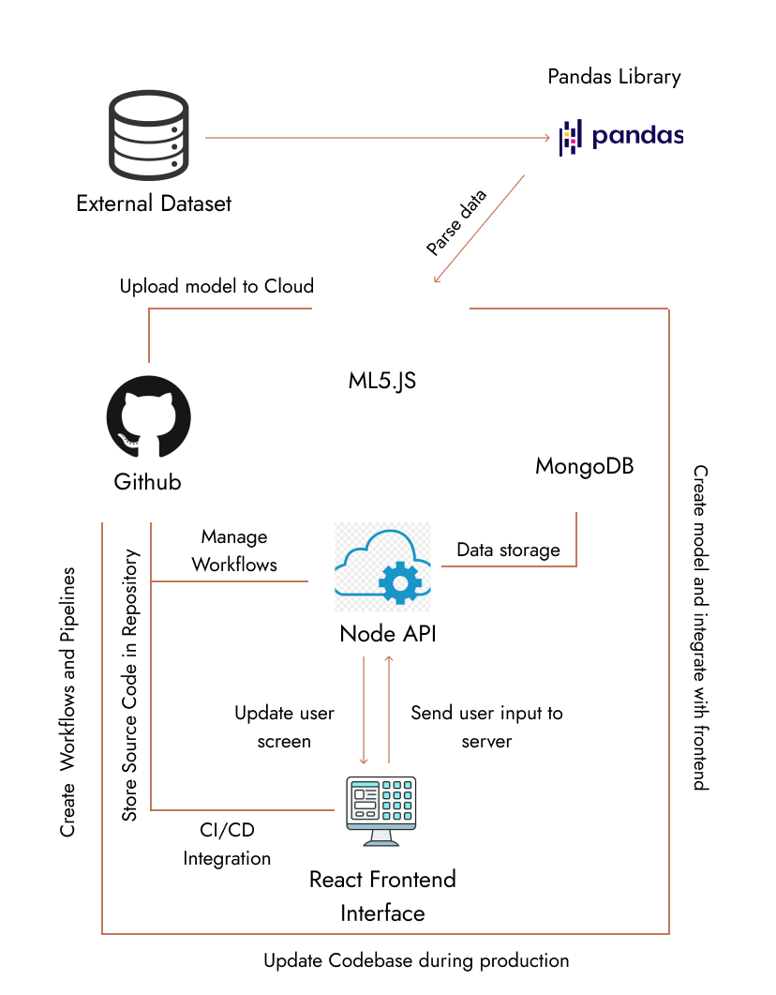
Figure 1: Architecture of the system

Slide 12
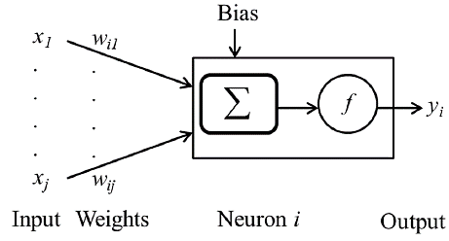



Figure 2: Mathematical Model of an ANN

Slide 13
IMPLEMENTATION
Neural Network
The Neural Network model makes classifications to predict the test results.
Web Interface
The web application allows the user to interact with the Neural Network and store user data on a web server

Slide 14
Neural Network
The Neural Network was built using a library called ML5.js
It uses a built-in logistic regression algorithm
The dataset was obtained from the Israel Ministry of Health and contains 1,048,576 patient data
The model has a training accuracy of 98.99% and a testing accuracy of 96.33%

Slide 15
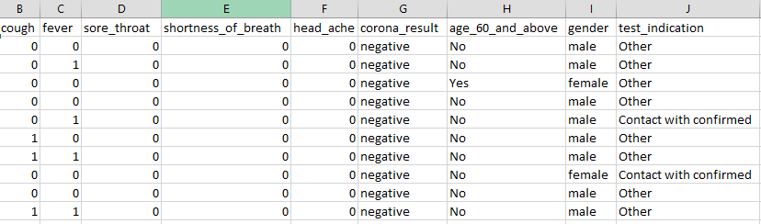
Neural Network
Figure 3: Dataset used to train the Neural Network

Slide 16
Other factors affecting user test result
Existing Medical conditions: Diabetes, HBP, Heart diseases
Vaccination status
Loss of smell
Loss of taste
Fatigue
Loss of appetite & Difficulty in swallowing food
Sleep cycle
Diarrhea

Slide 17
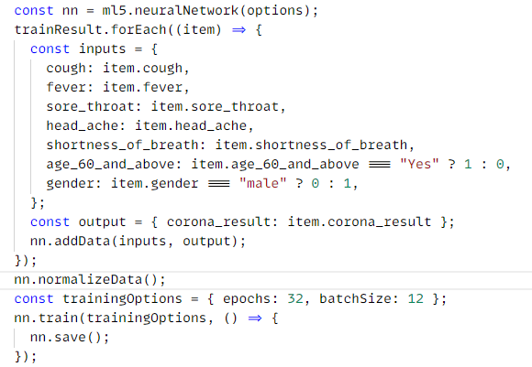
Figure 4: Training the Neural Network

Slide 18
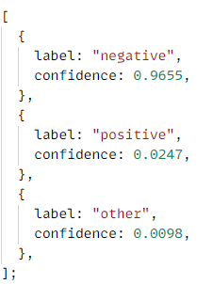
Figure 5: Sample Classification Result

Slide 19
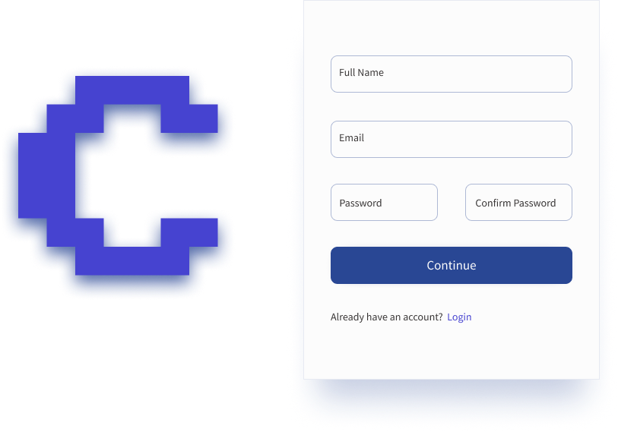
Web Interface
https://copodtwo.netlify.app/

Slide 20
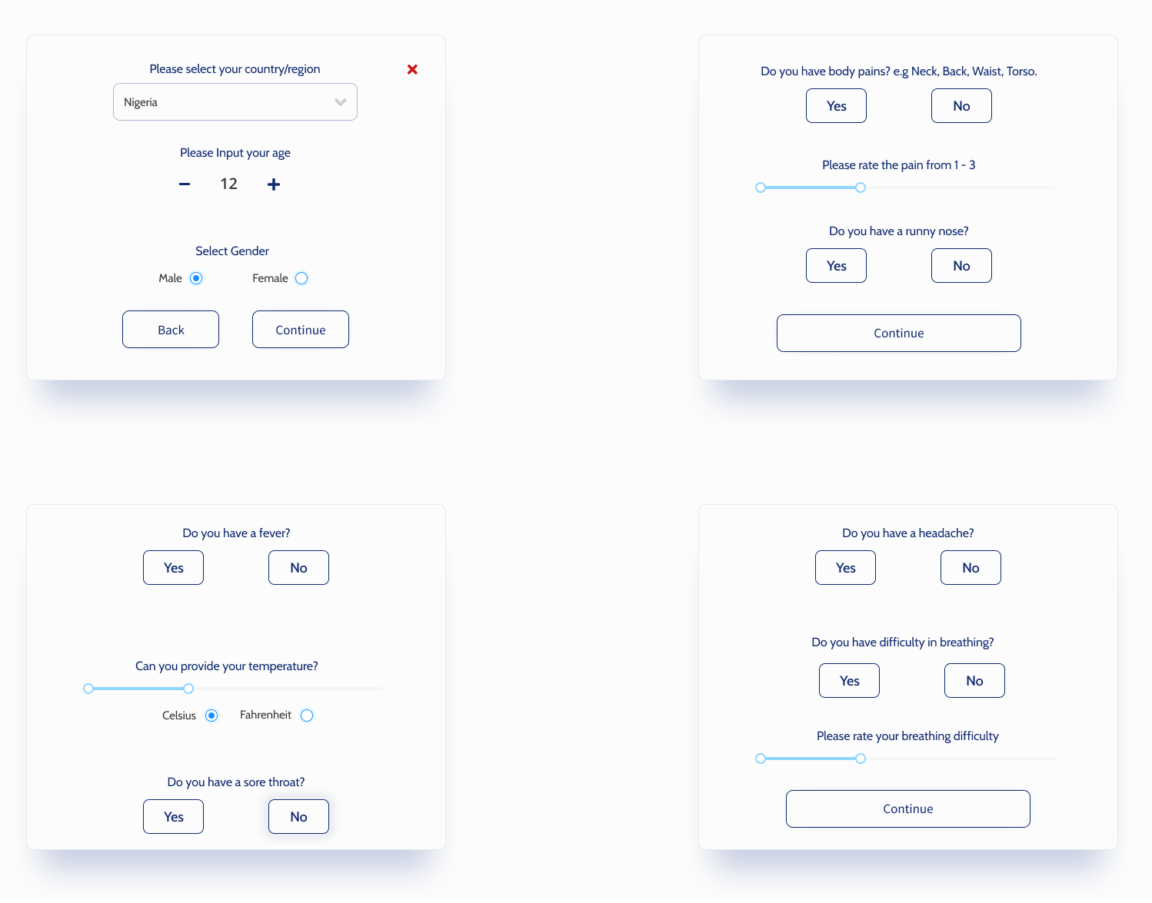
Web Interface
https://copodtwo.netlify.app/

Slide 21
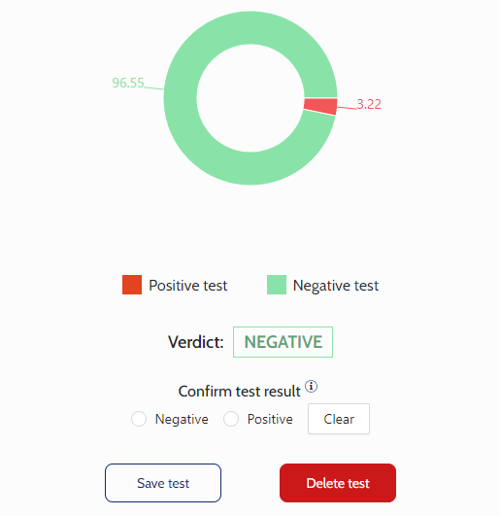
Web Interface
https://copodtwo.netlify.app/

Slide 22
CONTRIBUTION TO KNOWLEDGE
Through the implementation of this model, triaging patients with COVID-19 by medical personnel can be done more effectively.
Patient symptoms and other information from individuals all over the world can also be recorded to provide data for future analysis and research

Slide 23
REFERENCES
Abbasi, W. A., Abbas, S. A., Andleeb, S., ul Islam, G., Ajaz, S. A., Arshad, K., Khalil, S., Anjam, A., Ilyas, K., Saleem, M., Chughtai, J., & Abbas, A. (2021). COVIDC: An expert system to diagnose COVID-19 and predict its severity using chest CT scans: Application in radiology. Informatics in Medicine Unlocked, 23, 100540. https://doi.org/10.1016/j.imu.2021.100540
Abdel-Basst, M., Mohamed, R., & Elhoseny, M. (2020). A model for the effective COVID-19 identification in uncertainty environment using primary symptoms and CT scans. Health Informatics Journal, 26(4), 3088–3105. https://doi.org/10.1177/1460458220952918
Afzal, A. (2020). Molecular diagnostic technologies for COVID-19: Limitations and challenges. Journal of Advanced Research, 26, 149–159. https://doi.org/10.1016/j.jare.2020.08.002

Slide 24
Albawi, S., Mohammed, T. A. M., & Alzawi, S. (2017). Layers of a Convolutional Neural Network. Ieee, 16.
Alsunaidi, S. J., Almuhaideb, A. M., Ibrahim, N. M., Shaikh, F. S., Alqudaihi, K. S., Alhaidari, F. A., Khan, I. U., Aslam, N., & Alshahrani, M. S. (2021). Applications of big data analytics to control covid‐19 pandemic. Sensors, 21(7). https://doi.org/10.3390/s21072282
Ananthi, S., & Hariganesh, S. (2015). A comprehensive study on cloud computing. ICIIECS 2015 - 2015 IEEE International Conference on Innovations in Information, Embedded and Communication Systems. https://doi.org/10.1109/ICIIECS.2015.7193151

Slide 25
Barnes, J. (2015). Azure Machine Learning Microsoft Azure Essentials. In Microsoft Press. http://www.microsoft.com
Brown, C., Chauhan, J., Grammenos, A., Han, J., Hasthanasombat, A., Spathis, D., Xia, T., Cicuta, P., & Mascolo, C. (2020). Exploring Automatic Diagnosis of COVID-19 from Crowdsourced Respiratory Sound Data. Proceedings of the ACM SIGKDD International Conference on Knowledge Discovery and Data Mining, 3474–3484. https://doi.org/10.1145/3394486.3412865
Carretero, J., & Blas, J. G. (2014). Introduction to cloud computing: platforms and solutions. Cluster Computing, 17(4), 1225–1229. https://doi.org/10.1007/s10586-014-0352-5
Fauci, A. S., Lane, H. C., & Redfield, R. R. (2020). Covid-19 — Navigating the Uncharted. New England Journal of Medicine, 382(13), 1268–1269. https://doi.org/10.1056/nejme2002387

Slide 26
Fegert, J. M., Vitiello, B., Plener, P. L., & Clemens, V. (2020). Challenges and burden of the Coronavirus 2019 (COVID-19) pandemic for child and adolescent mental health: A narrative review to highlight clinical and research needs in the acute phase and the long return to normality. Child and Adolescent Psychiatry and Mental Health, 14(1), 1–11. https://doi.org/10.1186/s13034-020-00329-3
Giri, A. K., & Rana, D. R. (2020). Charting the challenges behind the testing of COVID-19 in developing countries: Nepal as a case study. Biosafety and Health, 2(2), 53–56. https://doi.org/10.1016/j.bsheal.2020.05.002
He, F., Deng, Y., & Li, W. (2020). Coronavirus disease 2019: What we know? Journal of Medical Virology, 92(7), 719–725. https://doi.org/10.1002/jmv.25766
Holstein, B. (2020). Coronavirus 101. Journal for Nurse Practitioners, 16(6), 416–419. https://doi.org/10.1016/j.nurpra.2020.03.021

Slide 27
THANK YOU!

